Slide 1
Mean of a list of data
Spider

Slide 2
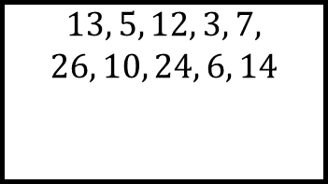
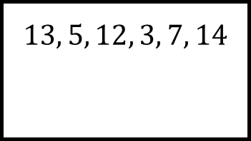
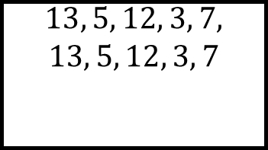
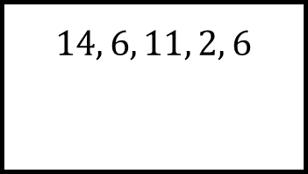
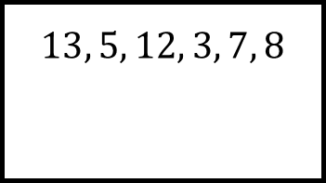
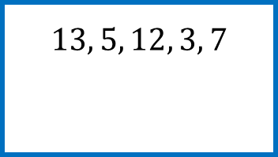
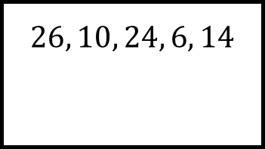
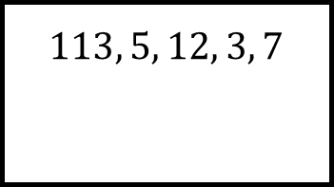
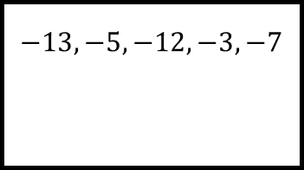
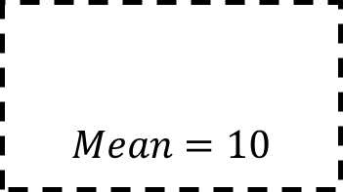
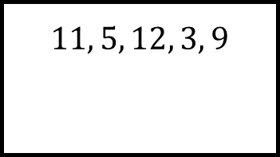
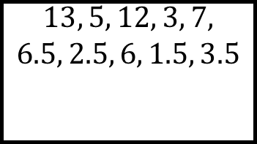
Reflect
Expect
$$14, 6, 11, 2, 6$$
$$26, 10, 24, 6, 14$$
$$13, 5, 12, 3, 7, 8$$
$$13, 5, 12, 3, 7, 14$$
$$−13, −5, −12, −3, −7$$
$$13, 5, 12, 3, 7,$$
$$13, 5, 12, 3, 7$$
$$13, 5, 12, 3, 7$$
$$113, 5, 12, 3, 7$$
$$13, 5, 12, 3, 7,$$
$$26, 10, 24, 6, 14$$
$$Mean=10$$
$$11, 5, 12, 3, 9$$
$$13, 5, 12, 3, 7,$$
$$6.5, 2.5, 6, 1.5, 3.5$$
Explain
Check

Slide 3
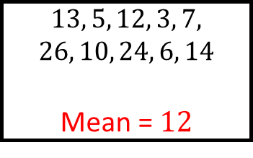
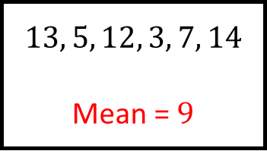
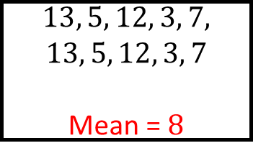
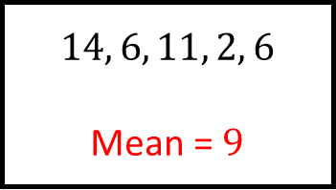
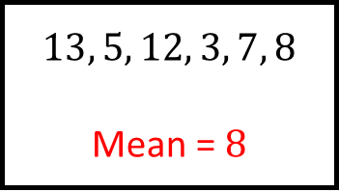
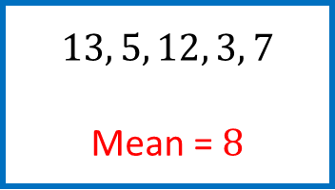
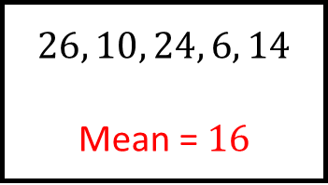
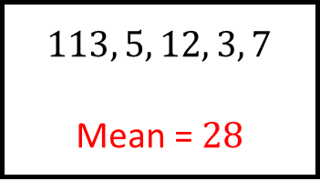
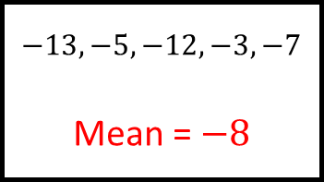
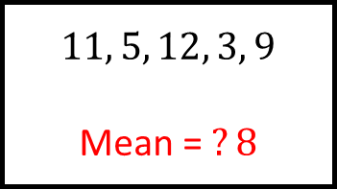
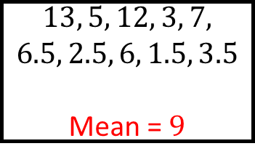
Reflect
Expect
$$14, 6, 11, 2, 6$$
Mean = $9$
$$26, 10, 24, 6, 14$$
Mean = $16$
$$13, 5, 12, 3, 7, 8$$
Mean = $8$
$$13, 5, 12, 3, 7, 14$$
Mean = $9$
$$−13, −5, −12, −3, −7$$
Mean = $−8$
$$13, 5, 12, 3, 7,$$
$$13, 5, 12, 3, 7$$
Mean = $8$
$$13, 5, 12, 3, 7$$
Mean = $8$
$$113, 5, 12, 3, 7$$
Mean = $28$
$$13, 5, 12, 3, 7,$$
$$26, 10, 24, 6, 14$$
Mean = $12$
$$Mean=10$$
$$11, 5, 12, 3, 9$$
Mean = $?8$
$$13, 5, 12, 3, 7,$$
$$6.5, 2.5, 6, 1.5, 3.5$$
Mean = $9$
Explain
Check

