Slide 1
Nth term of a linear sequence
Spider

Slide 2
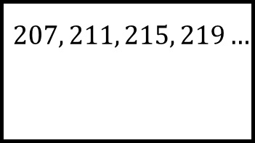
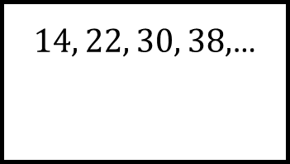
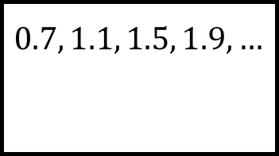
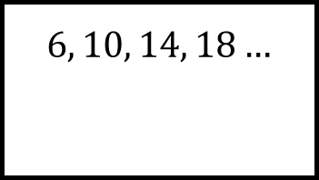
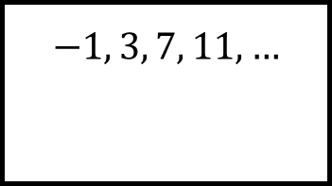
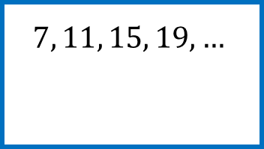
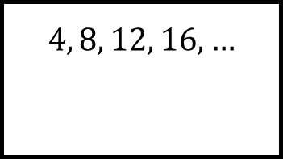
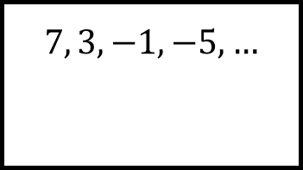
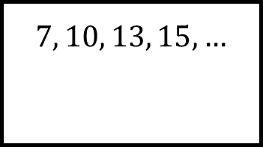
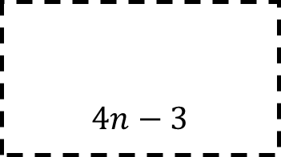
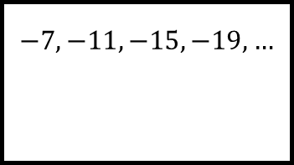
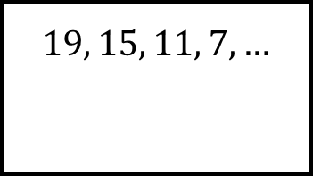
Reflect
Expect
$$6, 10, 14, 18…$$
$$4, 8, 12, 16, …$$
$$−1, 3, 7, 11, …$$
$14, 22, 30, 38,$…
$$7, 10, 13, 15,…$$
$$0.7, 1.1, 1.5, 1.9,…$$
$$7, 11, 15, 19, …$$
$$7, 3, −1, −5,…$$
$$207, 211, 215, 219…$$
$$4n−3$$
$$−7, −11,−15,−19,…$$
$$19, 15, 11, 7,…$$
Explain
Check

Slide 3
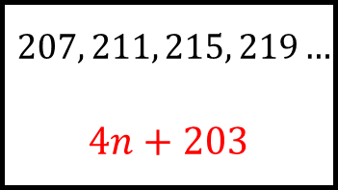
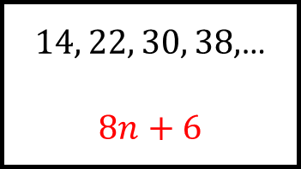
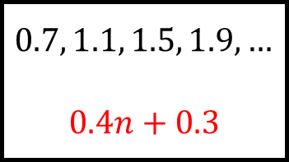
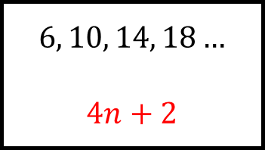
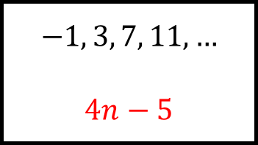
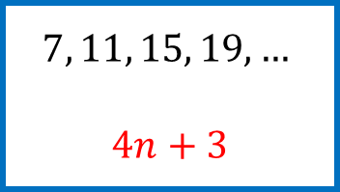
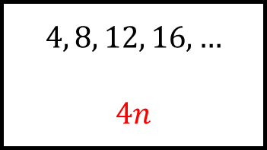
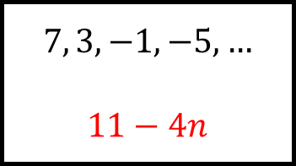
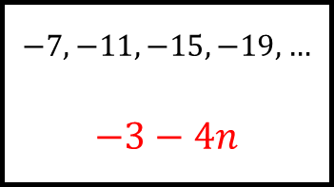
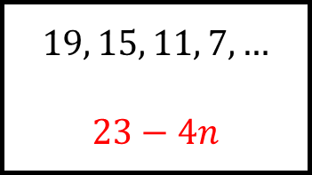
Reflect
Expect
$$6, 10, 14, 18…$$
$$4n+2$$
$$4, 8, 12, 16, …$$
$$4n$$
$$−1, 3, 7, 11, …$$
$$4n−5$$
$14, 22, 30, 38,$…
$$8n+6$$
$$7, 10, 13, 15,…$$
$$3n+4$$
$$0.7, 1.1, 1.5, 1.9,…$$
$$0.4n+0.3$$
$$7, 11, 15, 19, …$$
$$4n+3$$
$$7, 3, −1, −5,…$$
$$11−4n$$
$$207, 211, 215, 219…$$
$$4n+203$$
$$4n−3$$
$$−7, −11,−15,−19,…$$
$$−3−4n$$
$$19, 15, 11, 7,…$$
$$23−4n$$
Explain
Check

