Slide 1

Expanding single brackets
Spider

Slide 2
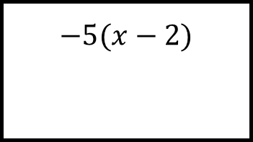
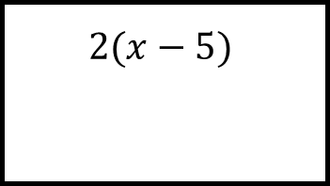
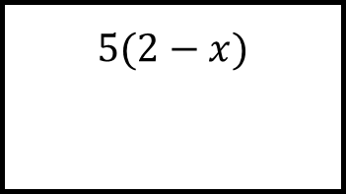
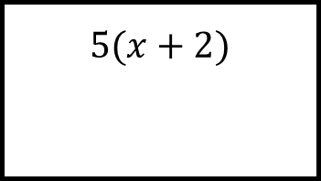
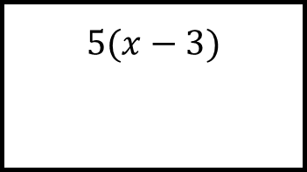
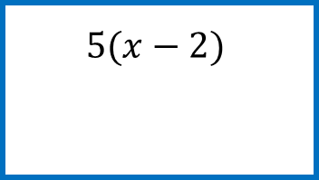
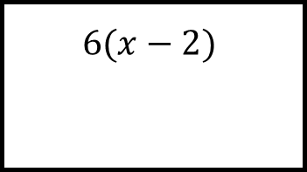
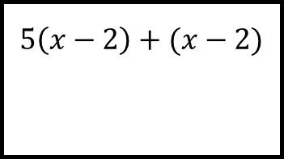
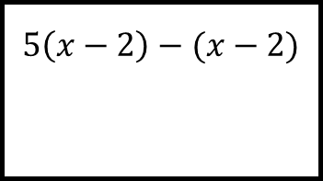
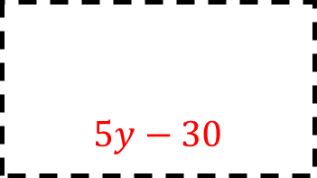
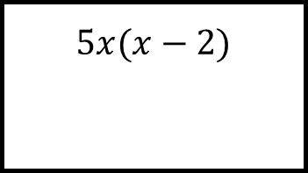
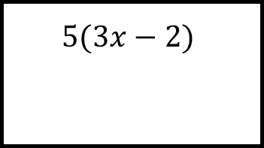
Reflect
Expect
$$5(x+2)$$
$$6(x−2)$$
$$5(x−3)$$
$$2(x−5)$$
$$5\left(x−2\right)−(x−2)$$
$$5(2−x)$$
$$5(x−2)$$
$$5\left(x−2\right)+(x−2)$$
$$−5(x−2)$$
$$5y−30$$
$$5x(x−2)$$
$$5(3x−2)$$
Explain
Check

Slide 3
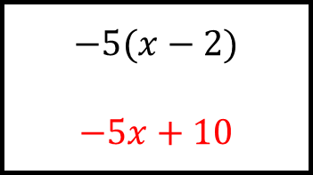
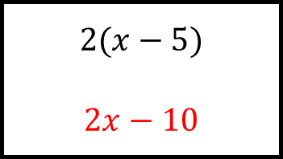
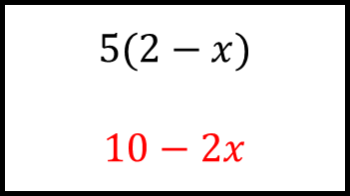
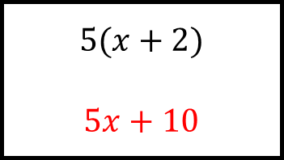
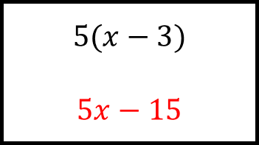
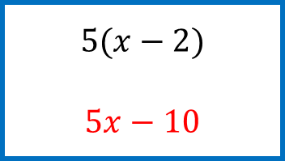
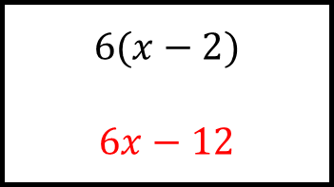
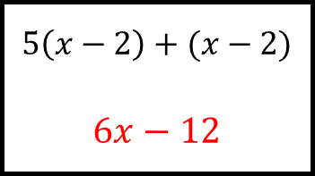
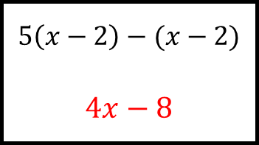
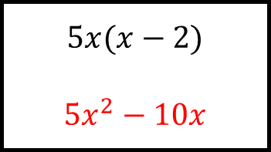
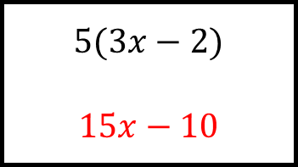
Reflect
Expect
$$5(x+2)$$
$$5x+10$$
$$6(x−2)$$
$$6x−12$$
$$5(x−3)$$
$$5x−15$$
$$2(x−5)$$
$$2x−10$$
$$5\left(x−2\right)−(x−2)$$
$$4x−8$$
$$5(2−x)$$
$$10−2x$$
$$5(x−2)$$
$$5x−10$$
$$5\left(x−2\right)+(x−2)$$
$$6x−12$$
$$−5(x−2)$$
$$−5x+10$$
$$5y−30$$
$$5x(x−2)$$
$${5x}^{2}−10x$$
$$5(3x−2)$$
$$15x−10$$
Explain
Check

