Slide 1
Factorising quadratic expressions
Spider

Slide 2
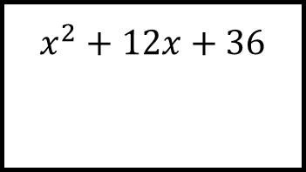
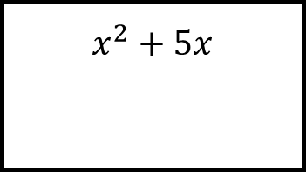
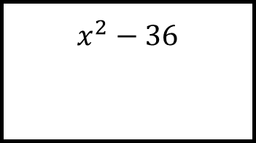
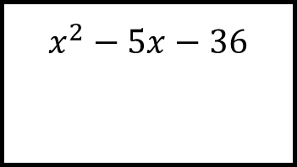
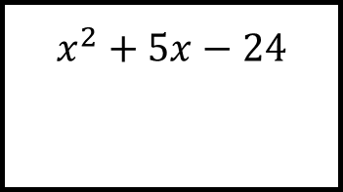
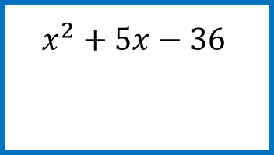
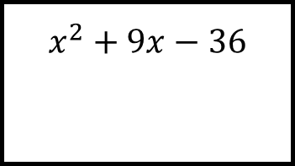
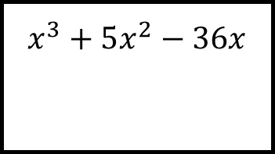
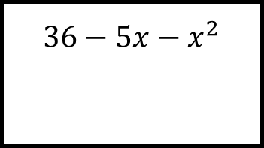
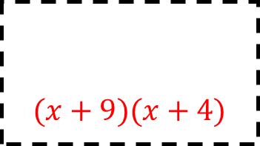
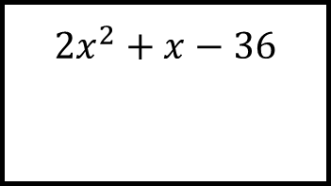
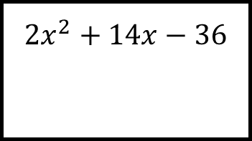
Reflect
Expect
$$x^{2}−5x−36$$
$$x^{2}+9x−36$$
$$x^{2}+5x−24$$
$$x^{2}+5x$$
$${36−5x−x}^{2}$$
$$x^{2}−36$$
$$x^{2}+5x−36$$
$$x^{3}+5x^{2}−36x$$
$$x^{2}+12x+36$$
$$(x+9)(x+4)$$
$${2x}^{2}+x−36$$
$${2x}^{2}+14x−36$$
Explain
Check

Slide 3
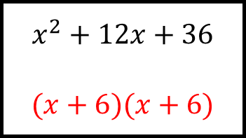
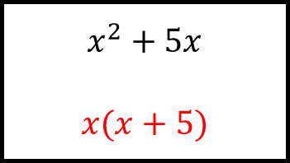
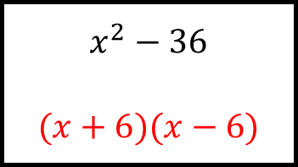
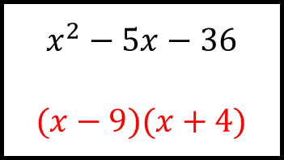
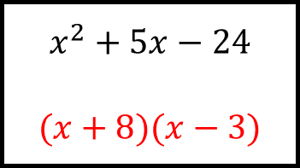
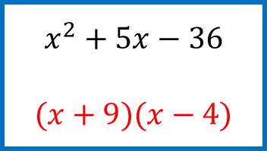
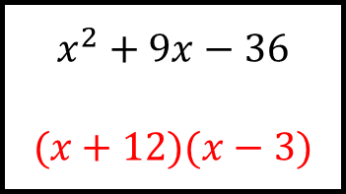
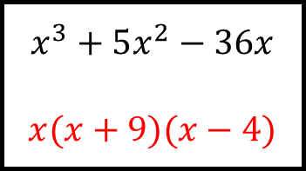
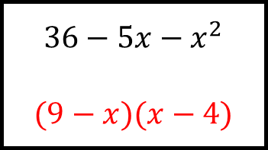
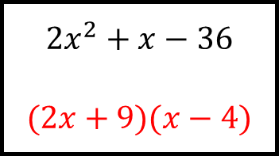
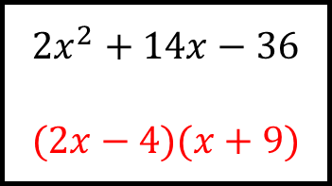
Reflect
Expect
$$x^{2}−5x−36$$
$$(x−9)(x+4)$$
$$x^{2}+9x−36$$
$$(x+12)(x−3)$$
$$x^{2}+5x−24$$
$$(x+8)(x−3)$$
$$x^{2}+5x$$
$$x(x+5)$$
$${36−5x−x}^{2}$$
$$(9−x)(x−4)$$
$$x^{2}−36$$
$$(x+6)(x−6)$$
$$x^{2}+5x−36$$
$$(x+9)(x−4)$$
$$x^{3}+5x^{2}−36x$$
$$x(x+9)(x−4)$$
$$x^{2}+12x+36$$
$$(x+6)(x+6)$$
$$(x+9)(x+4)$$
$${2x}^{2}+x−36$$
$$(2x+9)(x−4)$$
$${2x}^{2}+14x−36$$
$$(2x−4)(x+9)$$
Explain
Check

