Slide 1
Rationalising the denominator
Spider

Slide 2
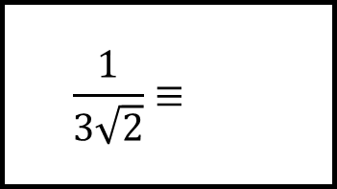
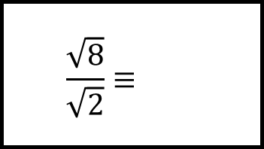
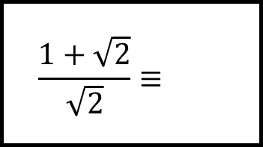
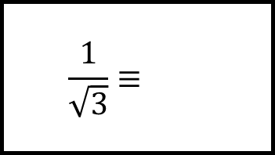
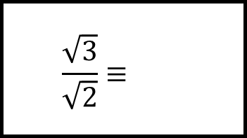
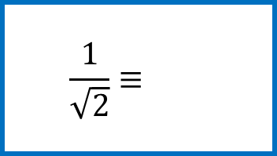
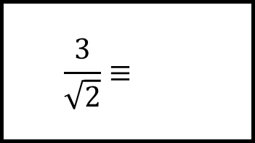
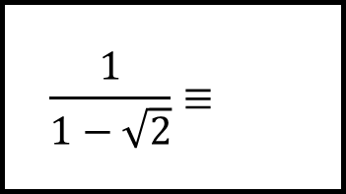
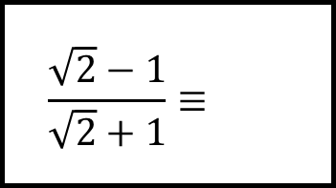
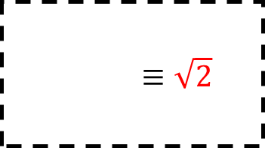
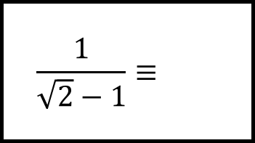
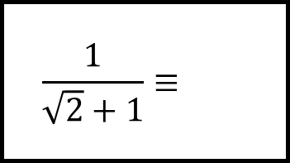
Reflect
Expect
$$\frac{1}{\sqrt{3}}≡$$
$$\frac{3}{\sqrt{2}}≡$$
$$\frac{\sqrt{3}}{\sqrt{2}}≡$$
$$\frac{\sqrt{8}}{\sqrt{2}}≡$$
$$\frac{\sqrt{2}−1}{\sqrt{2}+1}≡$$
$$\frac{1+\sqrt{2}}{\sqrt{2}}≡$$
$$\frac{1}{\sqrt{2}}≡$$
$$\frac{1}{1−\sqrt{2}}≡$$
$$\frac{1}{3\sqrt{2}}≡$$
$$≡\sqrt{2}$$
$$\frac{1}{\sqrt{2}−1}≡$$
$$\frac{1}{\sqrt{2}+1}≡$$
Explain
Check

Slide 3
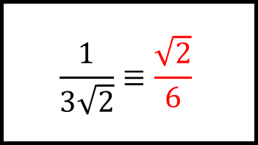
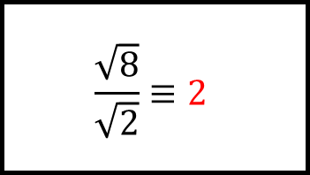
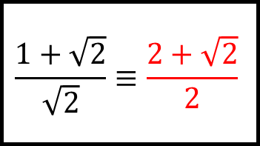
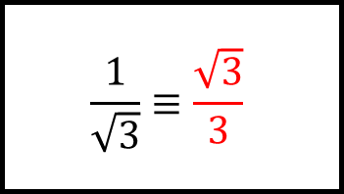
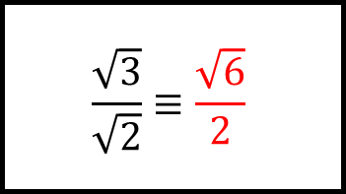
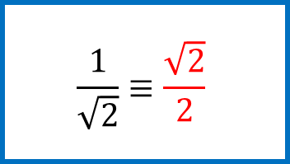
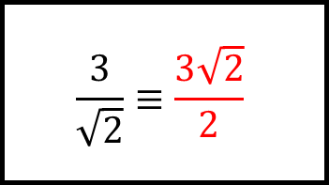
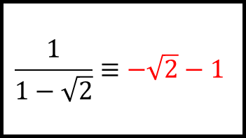
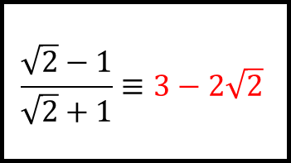
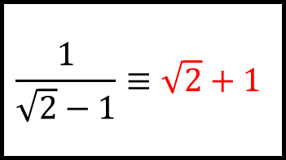
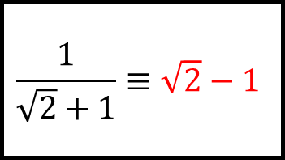
Reflect
Expect
$$\frac{1}{\sqrt{3}}≡\frac{\sqrt{3}}{3}$$
$$\frac{3}{\sqrt{2}}≡\frac{3\sqrt{2}}{2}$$
$$\frac{\sqrt{3}}{\sqrt{2}}≡\frac{\sqrt{6}}{2}$$
$$\frac{\sqrt{8}}{\sqrt{2}}≡2$$
$$\frac{\sqrt{2}−1}{\sqrt{2}+1}≡3−2\sqrt{2}$$
$$\frac{1+\sqrt{2}}{\sqrt{2}}≡\frac{2+\sqrt{2}}{2}$$
$$\frac{1}{\sqrt{2}}≡\frac{\sqrt{2}}{2}$$
$$\frac{1}{1−\sqrt{2}}≡−\sqrt{2}−1$$
$$\frac{1}{3\sqrt{2}}≡\frac{\sqrt{2}}{6}$$
$$≡\sqrt{2}$$
$$\frac{1}{\sqrt{2}−1}≡\sqrt{2}+1$$
$$\frac{1}{\sqrt{2}+1}≡\sqrt{2}−1$$
Explain
Check

