Slide 1
Pythagoras – Multiple Steps
Silent
Teacher
Intelligent Practice
Narration
Your Turn
Practice

Slide 2
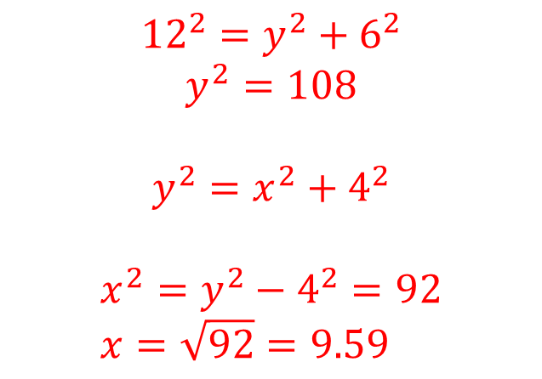
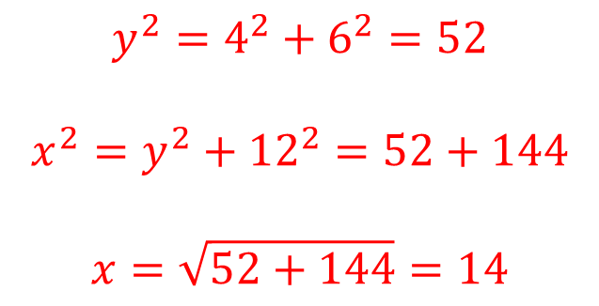
Worked Example
Your Turn
$$x$$
12
$$y$$
4
$$y$$
4
12
6
6
$$x$$
$$y^{2}=4^{2}+6^{2}=52$$
$$x^{2}=y^{2}+{12}^{2}=52+144$$
$$x=\sqrt{52+144}=14$$
$${12}^{2}=y^{2}+6^{2}$$
$$y^{2}=108$$
$$y^{2}=x^{2}+4^{2}$$
$$x^{2}=y^{2}−4^{2}=92 \\ x=\sqrt{92}=9.59$$
@cpotter

Slide 3
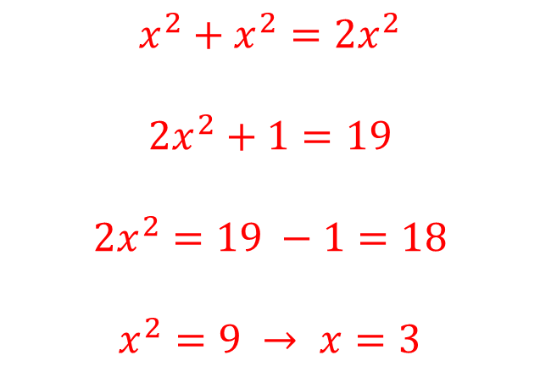
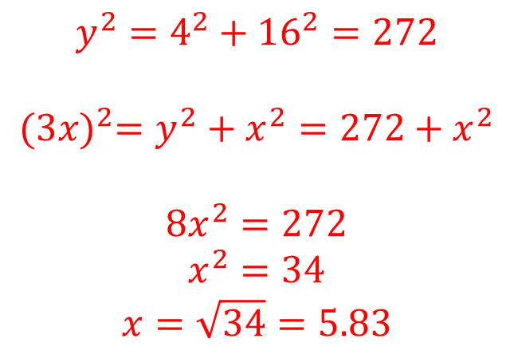
Worked Example
Your Turn
$$3x$$
$$\sqrt{19}$$
$$y$$
16
$$x\sqrt{2}$$
x
$$x$$
1
4
$$x$$
$$y^{2}=4^{2}+{16}^{2}=272$$
$${(3x)}^{2}=y^{2}+x^{2}=272+x^{2}$$
$$8x^{2}=272$$
$$x^{2}=34$$
$$x=\sqrt{34}=5.83$$
$$x^{2}+x^{2}=2x^{2}$$
$$2x^{2}+1=19$$
$$2x^{2}=19 −1=18$$
$$x^{2}=9 → x=3$$
@cpotter

Slide 4
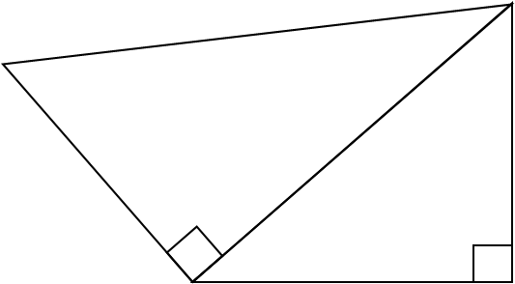
$$x$$
2
$$x$$
1
1
1
1
$$x$$
2
1
1
1
$$x$$
$$x$$
$$x$$
2
2
2
2
1
1
1
2
1
$$x$$
$$3$$
$$3$$
$$\sqrt{2}$$
$$x$$
$$x$$
1
$$x$$
$$\sqrt{2}$$
$$\sqrt{2}$$
2
$$x$$

Slide 5
$$\sqrt{3}$$
Answers
$$x$$
2
$$x$$
$$\sqrt{2}$$
1
$$\sqrt{2}$$
1
1
1
$$x$$
2
$$\sqrt{2}$$
1
1
1
$$x$$
$$x$$
$$x$$
2
2
2
2
1
1
1
2
1
$$x$$
$$3$$
$$3$$
$$\sqrt{2}$$
$$x$$
$$x$$
1
$$x$$
$$\sqrt{2}$$
$$\sqrt{2}$$
2
$$x$$

Slide 6
Answers
$$\sqrt{6}$$
$$\sqrt{3}$$
$$x$$
2
$$x$$
$$\sqrt{2}$$
1
$$\sqrt{2}$$
1
1
1
$$x$$
2
$$\sqrt{2}$$
$$\sqrt{2}$$
1
1
1
$$3$$
$$3$$
$$\sqrt{6}$$
$$x$$
$$x$$
$$x$$
$$\sqrt{5}$$
2
2
$$\sqrt{5}$$
2
2
1
2$\sqrt{2}$
1
1
2
1
$$\sqrt{6}$$
$$x$$
$$3$$
$$3$$
$$x$$
$$\sqrt{3}$$
$$\sqrt{2}$$
$$2$$
$$x$$
$$4$$
1
$$2\sqrt{2}$$
$$x$$
$$x\sqrt{2}$$
$$\sqrt{2}$$
$$\sqrt{3}$$
$$\sqrt{2}$$
2
$$x$$
$$\sqrt{3}$$

