Slide 1
Simultaneous Equations without multiplying: Add or subtract?
Add/subtract
Reflect
Your Turn
$$7a+3b=10 \\ 4a+3b=13$$
$$5a+6b=1 \\ 6b+9a=13$$
Rule

Slide 2
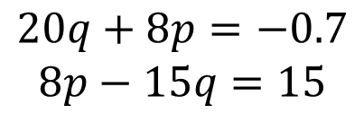
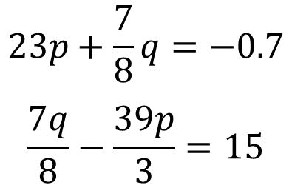
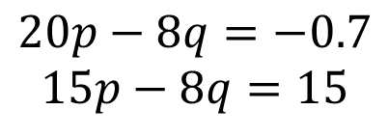
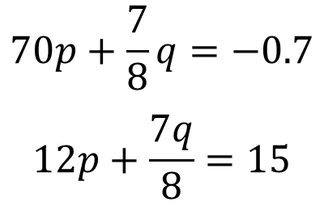
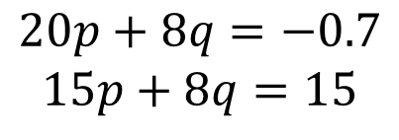
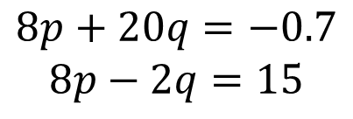
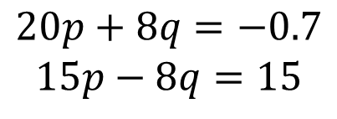
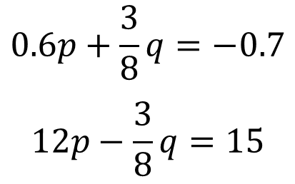
$$20p+8q=−0.7$$
$$15p−8q=15$$
$$−20p+7q=−0.7$$
$$−7q−15p=15$$
Add / Subtract
Add / Subtract
$$20p+8q=−0.7$$
$$15p+8q=15$$
$$0.6p+\frac{3}{8}q=−0.7$$
$$12p−\frac{3}{8}q=15$$
Add / Subtract
Add / Subtract
$$20p−8q=−0.7$$
$$15p−8q=15$$
Add / Subtract
$$70p+\frac{7}{8}q=−0.7$$
$$12p+\frac{7q}{8}=15$$
$$−20p−8q=−0.7$$
$$−15p−8q=15$$
Add / Subtract
Add / Subtract
$$8p+20q=−0.7$$
$$8p−2q=15$$
Add / Subtract
$$23p+\frac{7}{8}q=−0.7$$
$$\frac{7q}{8}−\frac{39p}{3}=15$$
$$20q+8p=−0.7$$
$$8p−15q=15$$
Add / Subtract
Add / Subtract
@mrdrapermaths
Notes:
Animated to appear one by one and answer one by one. Variation is used in each example. Values have been chosen that give grim answers to discourage pupils from working out the entire answer and instead focusing instead on just the first step.

Slide 3
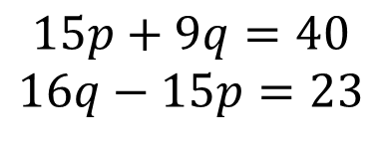
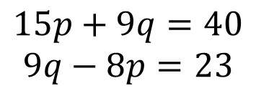
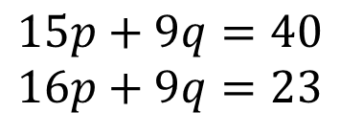
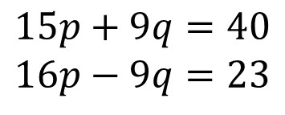
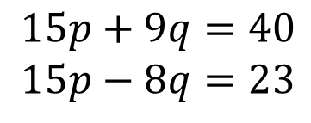
Your Turn
$$15p+9q=40$$
$$15p−8q=23$$
Add / Subtract
$$15p+9q=40$$
$$16p−9q=23$$
Add / Subtract
$$15p+9q=40$$
$$16p+9q=23$$
Add / Subtract
$$15p+9q=40$$
$$9q−8p=23$$
Add / Subtract
$$15p+9q=40$$
$$16q−15p=23$$
Add / Subtract
@mrdrapermaths
Notes:
Values have been chosen that give grim answers to discourage pupils from working out the entire answer and instead focusing instead on just the first step.

Slide 4
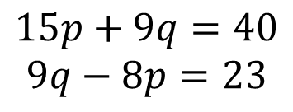
Your Turn
$$15p+9q=40$$
$$15p−8q=23$$
Add / Subtract
$$15p+9q=40$$
$$16p−9q=23$$
Add / Subtract
$$15p+9q=40$$
$$16p+9q=23$$
Add / Subtract
$$15p+9q=40$$
$$9q−8p=23$$
Add / Subtract
$$15p+9q=40$$
$$16q−15p=23$$
Add / Subtract
@mrdrapermaths
Notes:
Values have been chosen that give grim answers to discourage pupils from working out the entire answer and instead focusing instead on just the first step.

