Slide 1
Simultaneous Equations: Solving (multiplying both equations)
Silent
Teacher
Intelligent Practice
Narration
Your Turn
$$5x+3y=19$$
$$2x+4y=16$$
$$4x−2y=8$$
$$3x+3y=24$$
Practice

Slide 2
Worked Example
Your Turn
$$5x+3y=19$$
$$2x+4y=16$$
$$2x+9y=15$$
$$5x+4y=19$$
$$3x+3y=24$$
$$4x−2y=8$$
$$8x+3y=46$$
$$5x−2y=21$$

Slide 3
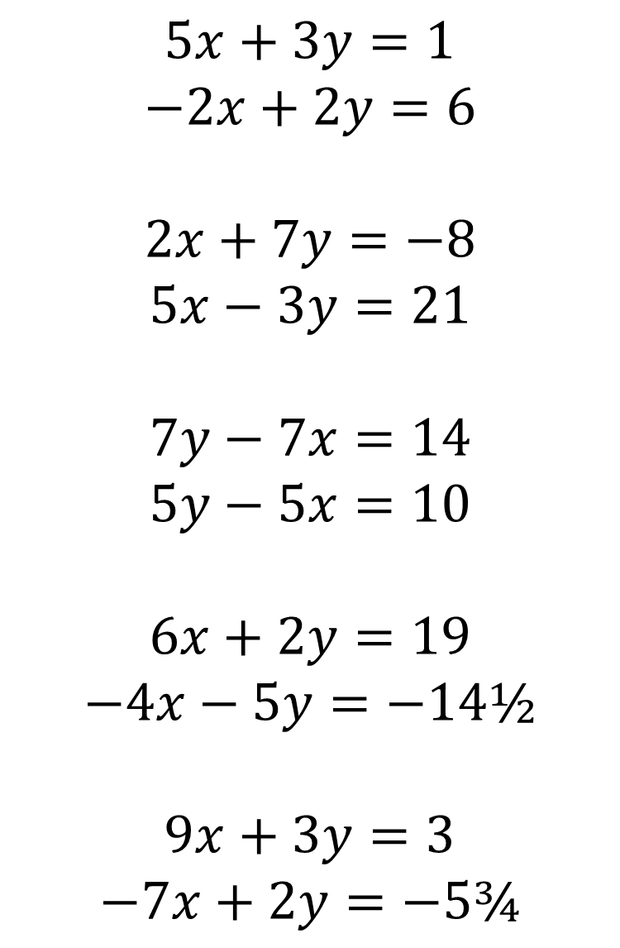
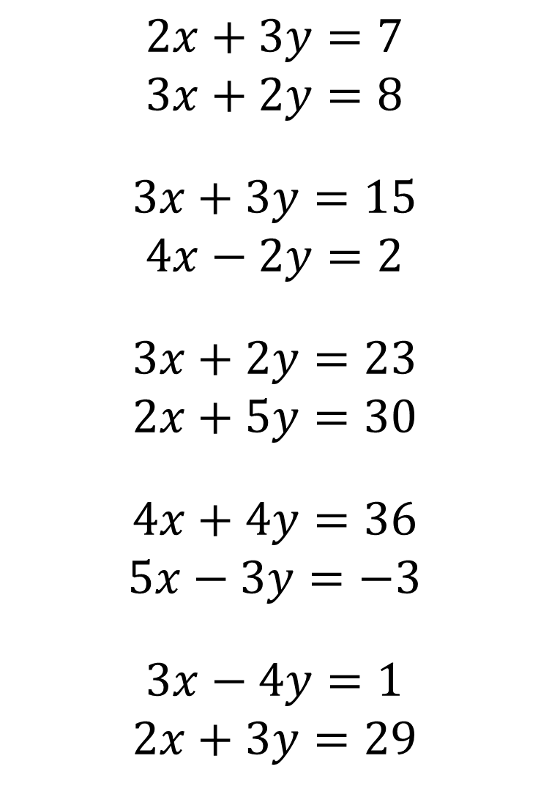
$$5x+3y=1$$
$$−2x+2y=6$$
$$2x+7y=−8$$
$$5x−3y=21$$
$$7y−7x=14$$
$$5y−5x=10$$
$$6x+2y=19$$
$$−4x−5y=−14½$$
$$9x+3y=3$$
$$−7x+2y=−5¾$$
$$2x+3y=7$$
$$3x+2y=8$$
$$3x+3y=15$$
$$4x−2y=2$$
$$3x+2y=23$$
$$2x+5y=30$$
$$4x+4y=36$$
$$5x−3y=−3$$
$$3x−4y=1$$
$$2x+3y=29$$

Slide 4
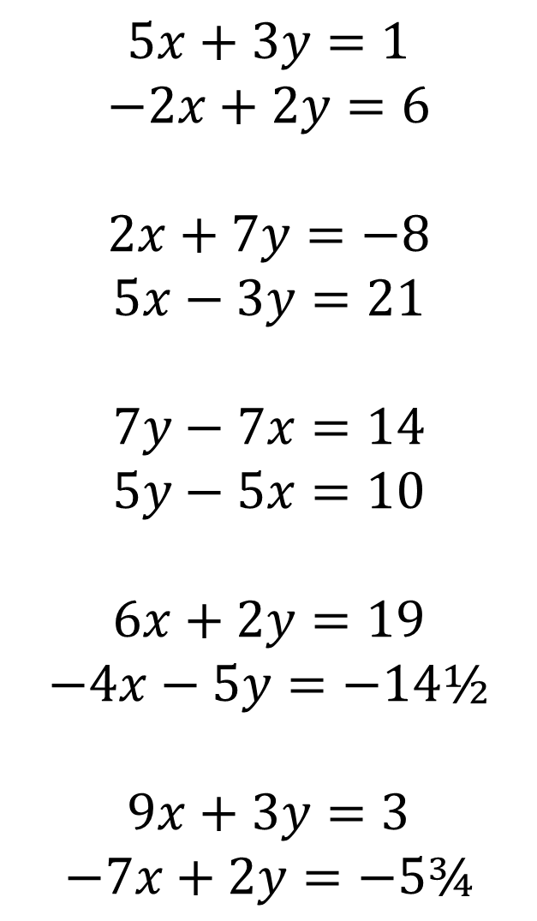
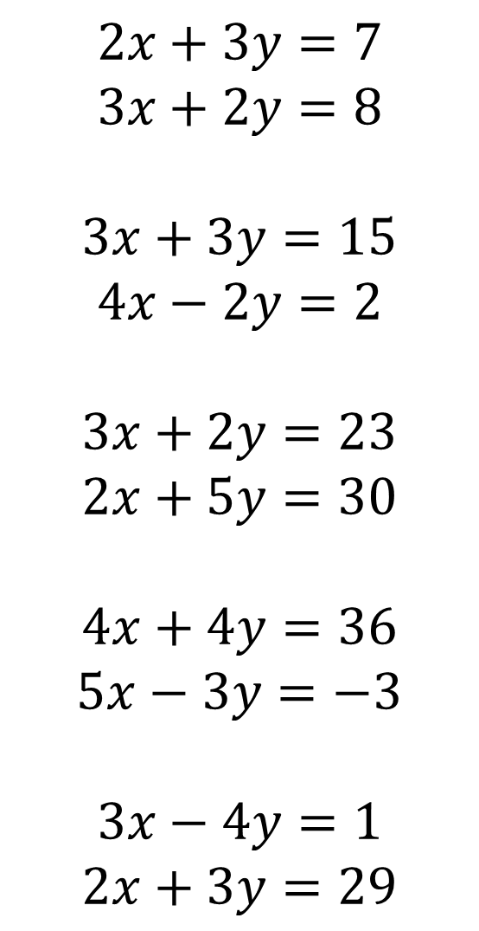
$$2x+3y=7$$
$$3x+2y=8$$
$$3x+3y=15$$
$$4x−2y=2$$
$$3x+2y=23$$
$$2x+5y=30$$
$$4x+4y=36$$
$$5x−3y=−3$$
$$3x−4y=1$$
$$2x+3y=29$$
$$5x+3y=1$$
$$−2x+2y=6$$
$$2x+7y=−8$$
$$5x−3y=21$$
$$7y−7x=14$$
$$5y−5x=10$$
$$6x+2y=19$$
$$−4x−5y=−14½$$
$$9x+3y=3$$
$$−7x+2y=−5¾$$
x = 2, y = 1
x = -1, y = 2
x = 2, y = 3
x = 3, y = -2
x = 5, y = 4
x = -3, y = -5
x = 3, y = 6
x = 3, y = ½
x = 7, y = 5
x = ¼, y = -2

