Slide 1
Can I find the gradient and y-intercept yet?
True/false
Reflect
Your Turn
$$y=3x−5$$
$$y=−5+3x$$
$$y−5=3x$$
CAVEAT: This task has been designed to encourage fluency in ‘seeing’ $y=mx+c$ as a structure. We want students to not have to rearrange $4−2x=y$ into $y=−2x+4$ to begin to recognise the properties of that graph. In asking if I can find gradient and y-intercept, we don’t mean is it possible – we mean can we do it immediately without another process. The ‘yet’ is doing a lot of heavy lifting here.
Rule

Slide 2
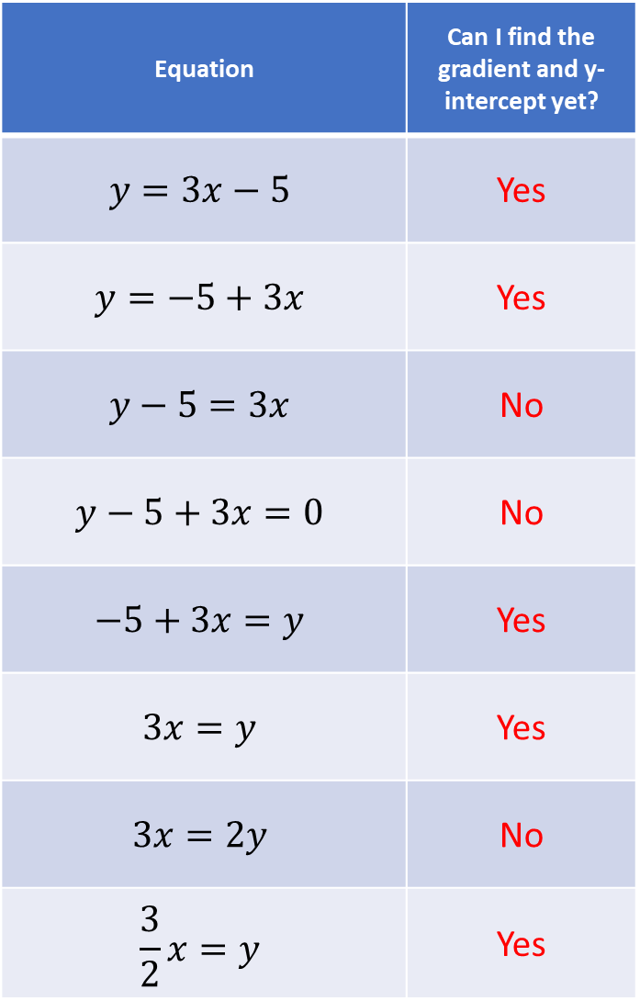
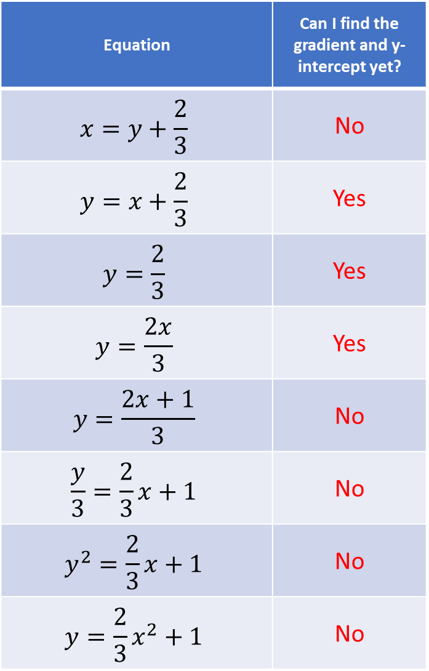
Equation | Can I find the gradient and y-intercept yet?
$$y=3x−5$$ | Yes
$$y=−5+3x$$ | Yes
$$y−5=3x$$ | No
$$y−5+3x=0$$ | No
$$−5+3x=y$$ | Yes
$$3x=y$$ | Yes
$$3x=2y$$ | No
$$\frac{3}{2}x=y$$ | Yes
Equation | Can I find the gradient and y-intercept yet?
$$x=y+\frac{2}{3}$$ | No
$$y=x+\frac{2}{3}$$ | Yes
$$y=\frac{2}{3}$$ | Yes
$$y=\frac{2x}{3}$$ | Yes
$$y=\frac{2x+1}{3}$$ | No
$$\frac{y}{3}=\frac{2}{3}x+1$$ | No
$$y^{2}=\frac{2}{3}x+1$$ | No
$$y=\frac{2}{3}x^{2}+1$$ | No

Slide 3
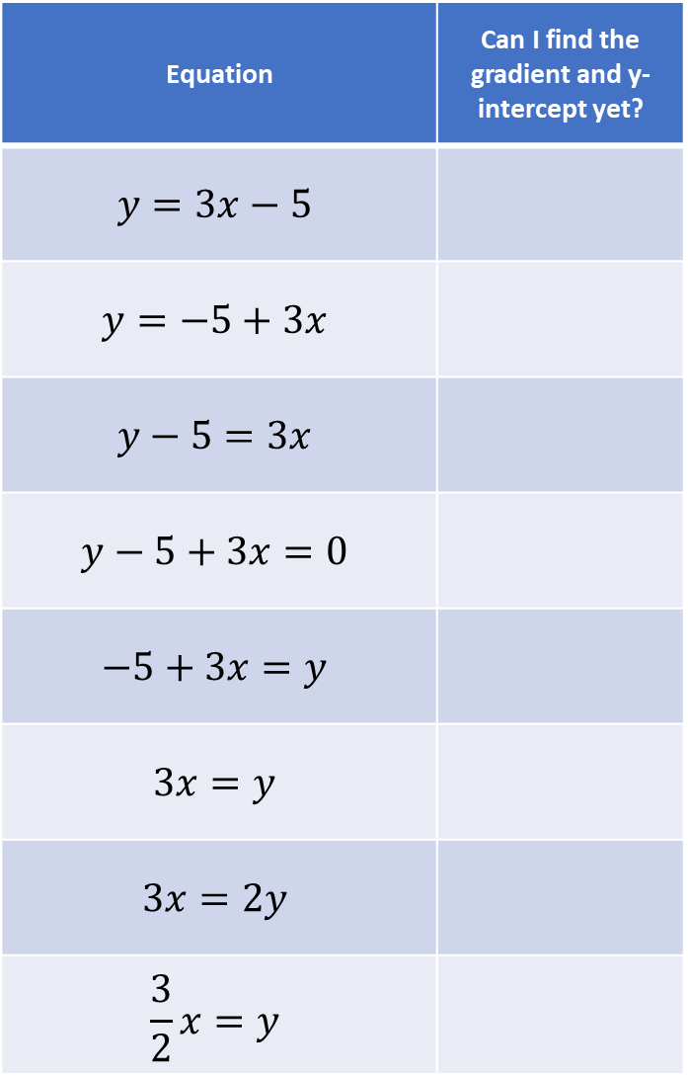
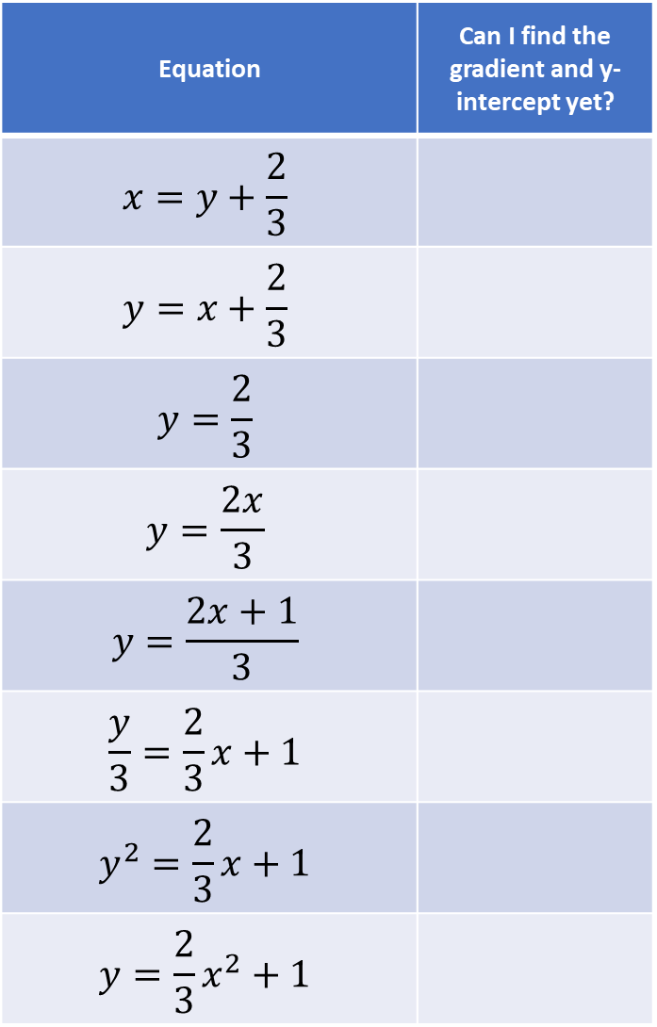
Equation | Can I find the gradient and y-intercept yet?
$$y=3x−5$$
$$y=−5+3x$$
$$y−5=3x$$
$$y−5+3x=0$$
$$−5+3x=y$$
$$3x=y$$
$$3x=2y$$
$$\frac{3}{2}x=y$$
Equation | Can I find the gradient and y-intercept yet?
$$x=y+\frac{2}{3}$$
$$y=x+\frac{2}{3}$$
$$y=\frac{2}{3}$$
$$y=\frac{2x}{3}$$
$$y=\frac{2x+1}{3}$$
$$\frac{y}{3}=\frac{2}{3}x+1$$
$$y^{2}=\frac{2}{3}x+1$$
$$y=\frac{2}{3}x^{2}+1$$

Slide 4
Equation | Can I find the gradient and y-intercept yet?
$$y=3x−5$$ | Yes
$$y=−5+3x$$ | Yes
$$y−5=3x$$ | No
$$y−5+3x=0$$ | No
$$−5+3x=y$$ | Yes
$$3x=y$$ | Yes
$$3x=2y$$ | No
$$\frac{3}{2}x=y$$ | Yes
Equation | Can I find the gradient and y-intercept yet?
$$x=y+\frac{2}{3}$$ | No
$$y=x+\frac{2}{3}$$ | Yes
$$y=\frac{2}{3}$$ | Yes
$$y=\frac{2x}{3}$$ | Yes
$$y=\frac{2x+1}{3}$$ | No
$$\frac{y}{3}=\frac{2}{3}x+1$$ | No
$$y^{2}=\frac{2}{3}x+1$$ | No
$$y=\frac{2}{3}x^{2}+1$$ | No

Slide 5
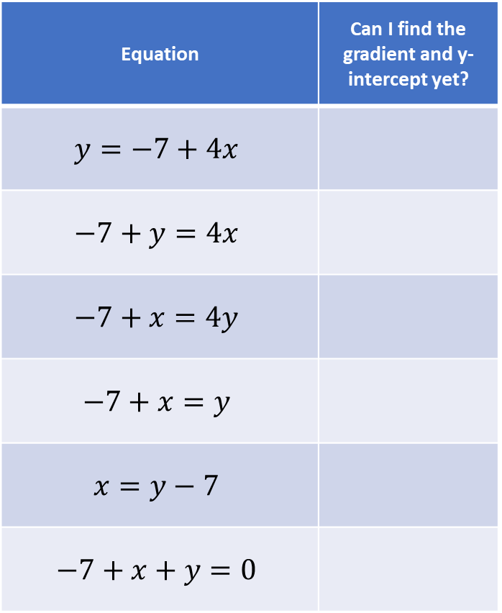
Your Turn
Equation | Can I find the gradient and y-intercept yet?
$$y=−7+4x$$
$$−7+y=4x$$
$$−7+x=4y$$
$$−7+x=y$$
$$x=y−7$$
$$−7+x+y=0$$

Slide 6
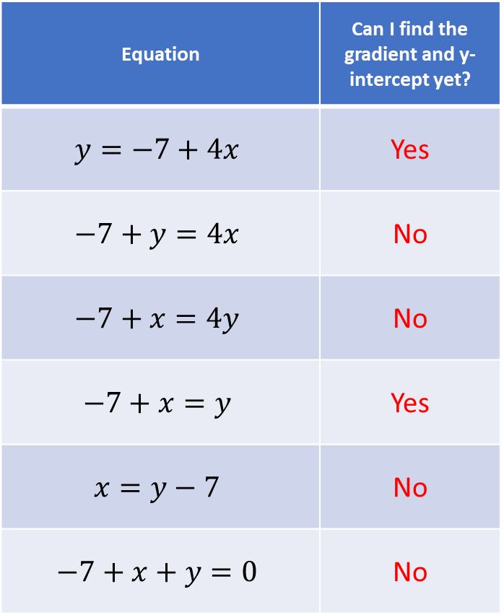
Your Turn - answers
Equation | Can I find the gradient and y-intercept yet?
$$y=−7+4x$$ | Yes
$$−7+y=4x$$ | No
$$−7+x=4y$$ | No
$$−7+x=y$$ | Yes
$$x=y−7$$ | No
$$−7+x+y=0$$ | No

