Slide 1
Arithmetic Sequences Finding a and d
Silent
Teacher
Intelligent Practice
Narration
Your Turn
$$5, 8, 11, 14, 17…$$
$$4, 7, 10, 13, 16…$$
$$2, 5, 9, 11, 15…$$
Practice

Slide 2
Worked Example
Your Turn
$$Find a and d for the following:$$
$$Find a and d for the following:$$
$$8, 15, 22, 29, 36…$$
$$11, 18, 25, 32, 39…$$

Slide 3
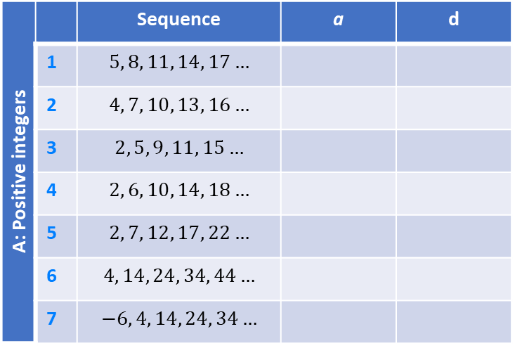
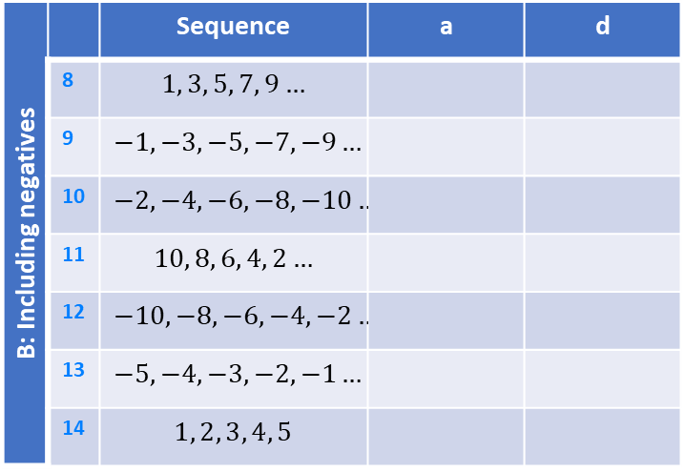
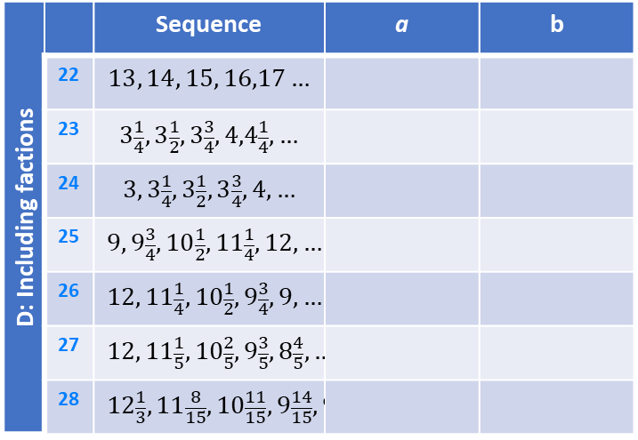
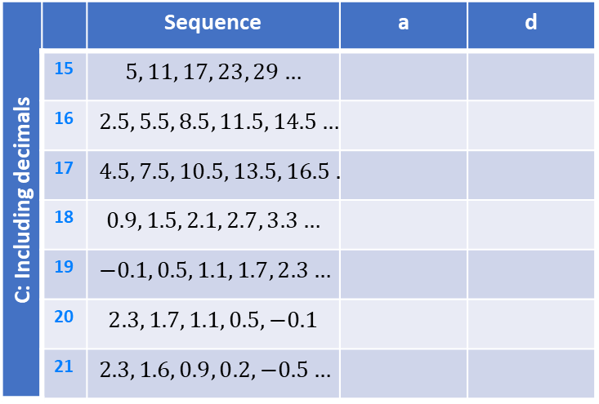
A: Positive integers |  | Sequence | a | d
 | 1 | $$5, 8, 11, 14, 17…$$
 | 2 | $$4, 7, 10, 13, 16…$$
 | 3 | $$2, 5, 9, 11, 15…$$
 | 4 | $$2, 6, 10, 14, 18…$$
 | 5 | $$2, 7, 12, 17, 22…$$
 | 6 | $$4, 14, 24, 34, 44…$$
 | 7 | $$−6, 4, 14, 24, 34…$$
B: Including negatives |  | Sequence | a | d
 | 8 | $$1, 3, 5, 7, 9…$$
 | 9 | $$−1, −3, −5, −7, −9…$$
 | 10 | $$−2, −4, −6, −8, −10…$$
 | 11 | $$10, 8, 6, 4, 2…$$
 | 12 | $$−10, −8, −6, −4, −2…$$
 | 13 | $$−5, −4, −3, −2, −1…$$
 | 14 | $$1, 2, 3, 4, 5$$
C: Including decimals |  | Sequence | a | d
 | 15 | $$5, 11, 17, 23, 29…$$
 | 16 | $$2.5, 5.5, 8.5, 11.5, 14.5…$$
 | 17 | $$4.5, 7.5, 10.5, 13.5, 16.5…$$
 | 18 | $$0.9, 1.5, 2.1, 2.7, 3.3…$$
 | 19 | $$−0.1, 0.5, 1.1, 1.7, 2.3…$$
 | 20 | $$2.3, 1.7, 1.1, 0.5, −0.1$$
 | 21 | $$2.3, 1.6, 0.9, 0.2, −0.5…$$
D: Including factions |  | Sequence | a | b
 | 22 | $$13, 14, 15, 16,17…$$
 | 23 | $$3\frac{1}{4},3\frac{1}{2},3\frac{3}{4},4,4\frac{1}{4},…$$
 | 24 | $$3, 3\frac{1}{4},3\frac{1}{2},3\frac{3}{4},4,…$$
 | 25 | $$9, 9\frac{3}{4},10\frac{1}{2},11\frac{1}{4},12,…$$
 | 26 | $$12, 11\frac{1}{4},10\frac{1}{2},9\frac{3}{4},9,…$$
 | 27 | $$12, 11\frac{1}{5},10\frac{2}{5},9\frac{3}{5},8\frac{4}{5},…$$
 | 28 | $$12\frac{1}{3}, 11\frac{8}{15},10\frac{11}{15},9\frac{14}{15},9\frac{2}{15},…$$
Notes:
9,

Slide 4
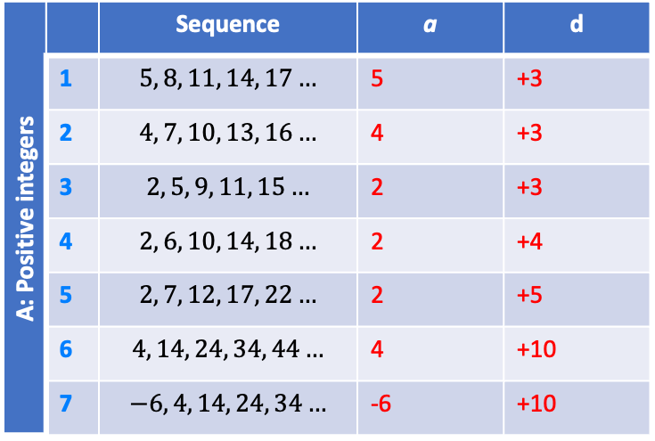
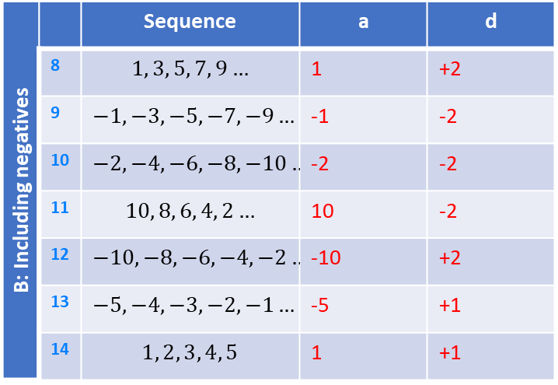
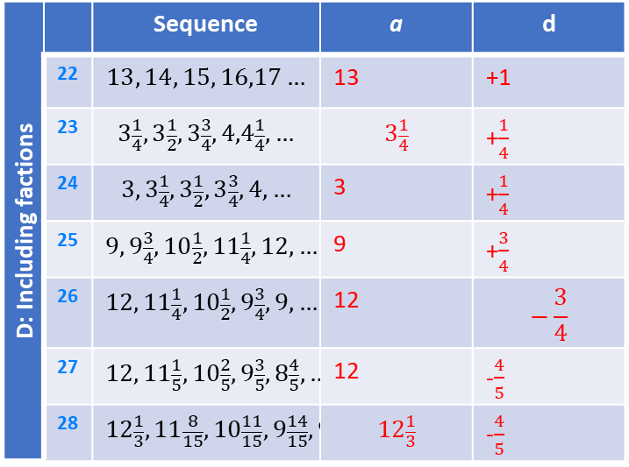
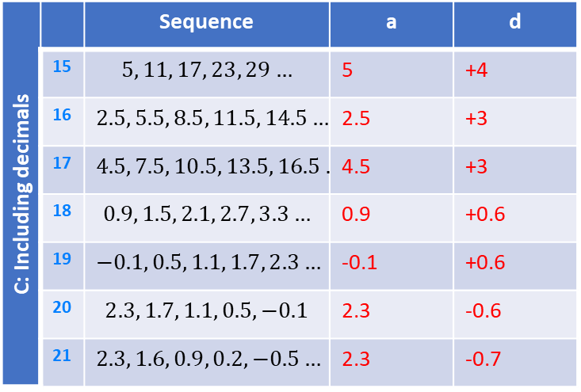
A: Positive integers |  | Sequence | a | d
 | 1 | $$5, 8, 11, 14, 17…$$ | 5 | +3
 | 2 | $$4, 7, 10, 13, 16…$$ | 4 | +3
 | 3 | $$2, 5, 9, 11, 15…$$ | 2 | +3
 | 4 | $$2, 6, 10, 14, 18…$$ | 2 | +4
 | 5 | $$2, 7, 12, 17, 22…$$ | 2 | +5
 | 6 | $$4, 14, 24, 34, 44…$$ | 4 | +10
 | 7 | $$−6, 4, 14, 24, 34…$$ | -6 | +10
B: Including negatives |  | Sequence | a | d
 | 8 | $$1, 3, 5, 7, 9…$$ | 1 | +2
 | 9 | $$−1, −3, −5, −7, −9…$$ | -1 | -2
 | 10 | $$−2, −4, −6, −8, −10…$$ | -2 | -2
 | 11 | $$10, 8, 6, 4, 2…$$ | 10 | -2
 | 12 | $$−10, −8, −6, −4, −2…$$ | -10 | +2
 | 13 | $$−5, −4, −3, −2, −1…$$ | -5 | +1
 | 14 | $$1, 2, 3, 4, 5$$ | 1 | +1
C: Including decimals |  | Sequence | a | d
 | 15 | $$5, 11, 17, 23, 29…$$ | 5 | +4
 | 16 | $$2.5, 5.5, 8.5, 11.5, 14.5…$$ | 2.5 | +3
 | 17 | $$4.5, 7.5, 10.5, 13.5, 16.5…$$ | 4.5 | +3
 | 18 | $$0.9, 1.5, 2.1, 2.7, 3.3…$$ | 0.9 | +0.6
 | 19 | $$−0.1, 0.5, 1.1, 1.7, 2.3…$$ | -0.1 | +0.6
 | 20 | $$2.3, 1.7, 1.1, 0.5, −0.1$$ | 2.3 | -0.6
 | 21 | $$2.3, 1.6, 0.9, 0.2, −0.5…$$ | 2.3 | -0.7
D: Including factions |  | Sequence | a | d
 | 22 | $$13, 14, 15, 16,17…$$ | 13 | +1
 | 23 | $$3\frac{1}{4},3\frac{1}{2},3\frac{3}{4},4,4\frac{1}{4},…$$ | $$3\frac{1}{4}$$ | +$\frac{1}{4}$
 | 24 | $$3, 3\frac{1}{4},3\frac{1}{2},3\frac{3}{4},4,…$$ | 3 | +$\frac{1}{4}$
 | 25 | $$9, 9\frac{3}{4},10\frac{1}{2},11\frac{1}{4},12,…$$ | 9 | +$\frac{3}{4}$
 | 26 | $$12, 11\frac{1}{4},10\frac{1}{2},9\frac{3}{4},9,…$$ | 12 | $$−\frac{3}{4}$$
 | 27 | $$12, 11\frac{1}{5},10\frac{2}{5},9\frac{3}{5},8\frac{4}{5},…$$ | 12 | -$\frac{4}{5}$
 | 28 | $$12\frac{1}{3}, 11\frac{8}{15},10\frac{11}{15},9\frac{14}{15},9\frac{2}{15},…$$ | $$12\frac{1}{3}$$ | -$\frac{4}{5}$
Notes:
9,

