Slide 1
General Binomial Expansion: Range of Validity
Silent
Teacher
Intelligent Practice
Narration
Your Turn
$${\left(1+x\right)}^{\frac{1}{2}} ⇒ \left|x\right|<1$$
$${\left(1+3x\right)}^{\frac{1}{2}} ⇒ \left|x\right|<\frac{1}{3}$$
Practice

Slide 2
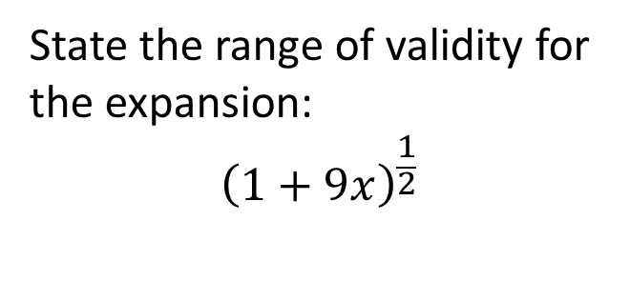
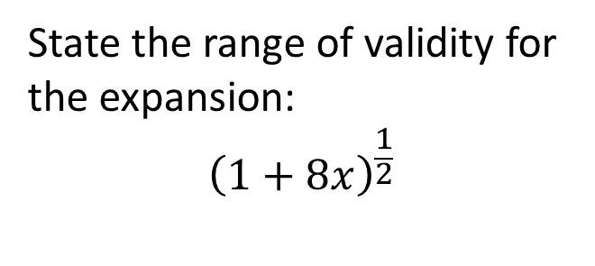
Worked Example
Your Turn
State the range of validity for the expansion:
$${\left(1+8x\right)}^{\frac{1}{2}}$$
State the range of validity for the expansion:
$${\left(1+9x\right)}^{\frac{1}{2}}$$
@ParkoMaths

Slide 3


1. ${\left(1+x\right)}^{\frac{1}{2}}$
2. ${\left(1+7x\right)}^{\frac{1}{2}}$
3. ${\left(1−7x\right)}^{\frac{1}{2}}$
4. ${\left(1−7x\right)}^{\frac{1}{3}}$
5. ${\left(1−7x\right)}^{−\frac{1}{3}}$
6. ${\left(1−7x\right)}^{−3}$
7. ${\left(1−7x\right)}^{3}$
8. ${(1−7x)}^{0.3}$
9. ${(1+7x)}^{0.3}$
10. ${\left(1+9x\right)}^{\frac{1}{2}}$
11. ${\left(1+\frac{9x}{4}\right)}^{\frac{1}{2}}$
12. ${\left(1+0.4x\right)}^{\frac{1}{2}}$
13. ${\left(1+4x\right)}^{\frac{1}{2}}$
14. ${\left(9+4x\right)}^{\frac{1}{2}}$
15. ${\left(9+4x\right)}^{\frac{1}{3}}$
16. ${\left(9+4x\right)}^{−3}$
17. ${\left(2+4x\right)}^{\frac{1}{2}}$
18. $\sqrt{2}+\sqrt{2}x−\frac{\sqrt{2}}{2}x^{2}+…$
@ParkoMaths

Slide 4
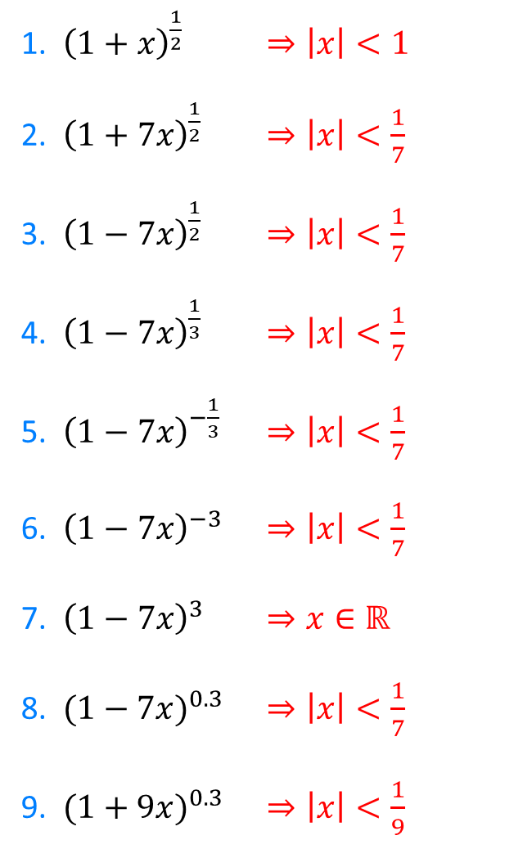
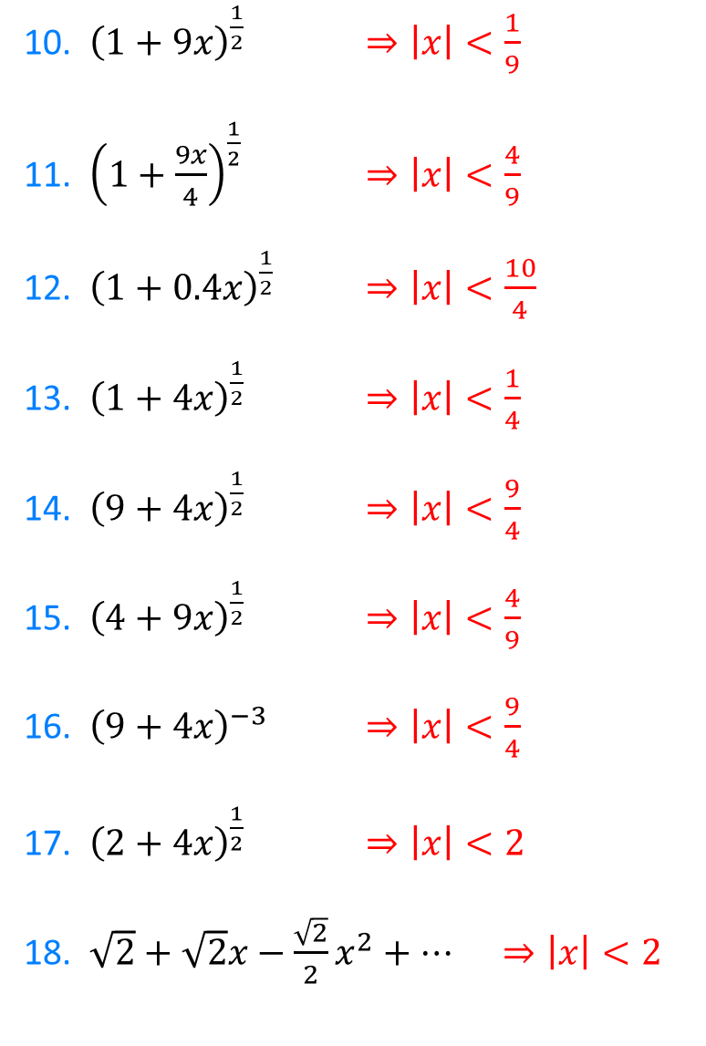
1. ${\left(1+x\right)}^{\frac{1}{2}}$ $⇒\left|x\right|<1$
2. ${\left(1+7x\right)}^{\frac{1}{2}}$ $⇒\left|x\right|<\frac{1}{7}$
3. ${\left(1−7x\right)}^{\frac{1}{2}}$ $⇒\left|x\right|<\frac{1}{7}$
4. ${\left(1−7x\right)}^{\frac{1}{3}}$ $⇒\left|x\right|<\frac{1}{7}$
5. ${\left(1−7x\right)}^{−\frac{1}{3}}$ $⇒\left|x\right|<\frac{1}{7}$
6. ${\left(1−7x\right)}^{−3}$ $⇒\left|x\right|<\frac{1}{7}$
7. ${\left(1−7x\right)}^{3}$ $⇒x∈ℝ$
8. ${(1−7x)}^{0.3}$ $⇒\left|x\right|<\frac{1}{7}$
9. ${(1+9x)}^{0.3}$ $⇒\left|x\right|<\frac{1}{9}$
10. ${\left(1+9x\right)}^{\frac{1}{2}}$ $⇒\left|x\right|<\frac{1}{9}$
11. ${\left(1+\frac{9x}{4}\right)}^{\frac{1}{2}}$ $⇒\left|x\right|<\frac{4}{9}$
12. ${\left(1+0.4x\right)}^{\frac{1}{2}}$ $⇒\left|x\right|<\frac{10}{4}$
13. ${\left(1+4x\right)}^{\frac{1}{2}}$ $⇒\left|x\right|<\frac{1}{4}$
14. ${\left(9+4x\right)}^{\frac{1}{2}}$ $⇒\left|x\right|<\frac{9}{4}$
15. ${\left(4+9x\right)}^{\frac{1}{2}}$ $⇒\left|x\right|<\frac{4}{9}$
16. ${\left(9+4x\right)}^{−3}$ $⇒\left|x\right|<\frac{9}{4}$
17. ${\left(2+4x\right)}^{\frac{1}{2}}$ $⇒\left|x\right|<2$
18. $\sqrt{2}+\sqrt{2}x−\frac{\sqrt{2}}{2}x^{2}+…$ $⇒\left|x\right|<2$
@ParkoMaths

