Slide 1
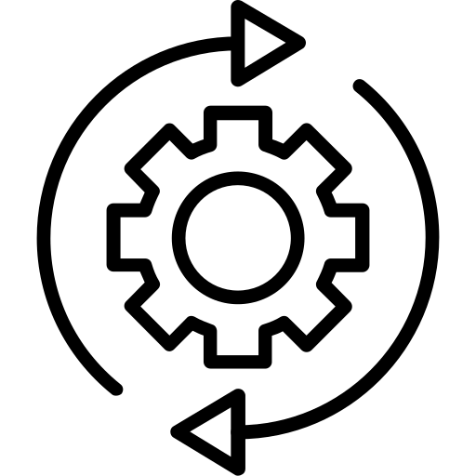
Transformation of functions (2 activities)
Silent
Teacher
Intelligent Practice
Narration
Your Turn
Practice

